Slide 1
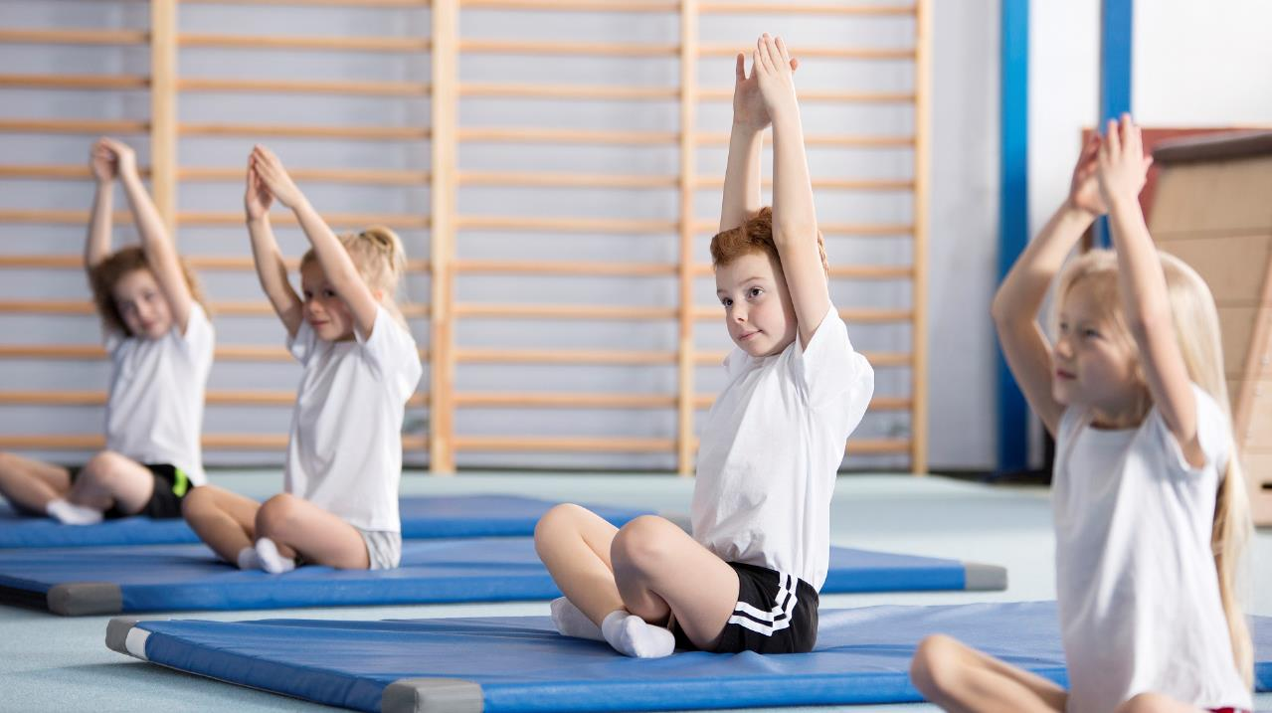

How can physical activity,
PE & sport help pupils overcome the impacts of lockdown?
The benefits of physical activity and children’s experience during lockdown
Module 1 of 3
Notes:
Welcome to this series of e-learning where we will explore physical activity as a tool for improving outcomes for pupils and schools, especially in light of the impacts that lockdown has had on young people.
These sessions have been written by Active Norfolk and will cover the benefits of physical activity, the impact of lockdown on activity, an update on the PE and Sports Premium and practical considerations of maximizing the impact of physical activity in your school.
There are 3 sessions that have been designed to be completed in sequence.
This is the first session where we will explore the benefits of physical activity, PE and school sport, consider how it can help minimize the negative impacts of lockdown on young people and look at the impacts of lockdown on activity behaviours.

Slide 2
Modules Overview
Module 1
‘How can physical activity, PE & school sport help pupils overcome the impacts of lockdown?’
Why improve your provision? (The benefits of physical activity)
Module 2
‘PE & Sport Premium Guidance 2020-21’
What are the conditions of the grant? (Updated grant guidance)
Module 3
‘Let’s rethink your PE & Sport Premium to achieve the best outcomes for pupils’
How can we maximise the benefits of physical activity in school?
Notes:
These sessions are appropriate to all educational settings including pupil referral units and special schools. Modules two and three explicitly deal with the PE and Sports Premium funding and so are applicable to any school receiving this funding, for settings not in receipt of this funding module 1 and much of the advice given in module 3 will remain relevant.
These sessions are applicable to any role interested in the health and wellbeing of pupils including senior leaders, governors, SENCos and PE leads.
There are 3 sessions that have been designed to be completed in sequence.
This is the first session where we will explore the benefits of physical activity, PE and school sport, consider how it can help minimize the negative impacts of lockdown on young people and look at the impacts of lockdown on activity behaviours.

Slide 3
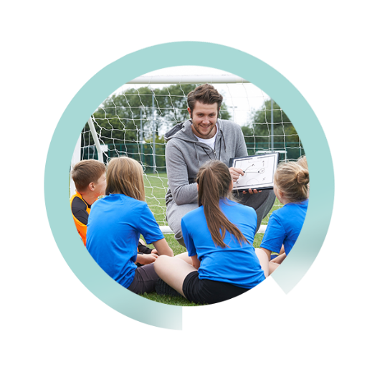
Objectives:
Understand the benefits of physical activity linked to the impacts of lockdown
Understand how children and young people’s physical activity habits have been impacted by lockdown
Understand how children and young people’s attitudes have changed towards sport and physical activity during lockdown
Notes:
This session will explore the breadth of benefits of physical activity for young people linked to the challenges and issues that have come about as a result of lockdown restrictions including:
- Deteriorating mental and physical health
Isolation, loneliness and anxiety about being social again
The learning gap and need for academic catch-up
We will then look at how habits and attitudes of young people and families have changed through the pandemic. This session will set the context for the following sessions on the extension of the PE and Sport Premium and the more practical session exploring how to maximise the benefits of physical activity, school sport and physical education in your school.

Slide 4
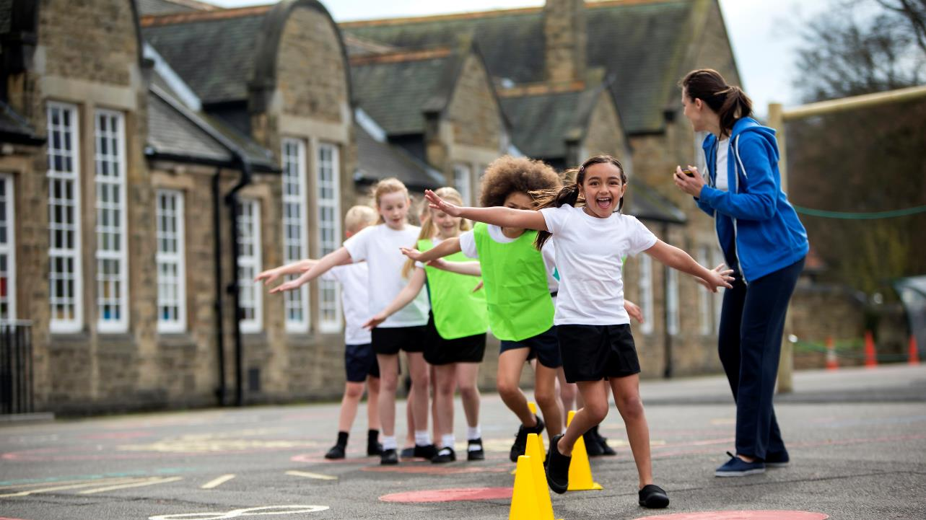
How can physical activity help my pupils’ outcomes?
Notes:
So let’s explore how physical activity can be used as a tool to improve outcomes for young people

Slide 5
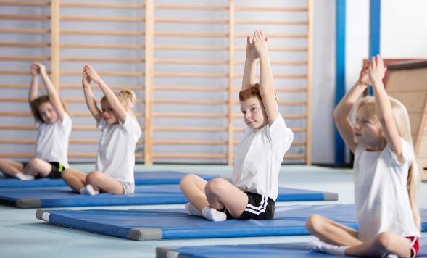
The benefits of physical activity
Mental health and emotional wellbeing
Strong association with improved:
  Self-esteem
  Anxiety
  Depression
  Mood
Building resilience
Notes:
We know that many young people’s mental health has suffered whilst being away from school and techniques and activities to support positive mental health have never been more important. Physical activity is a fantastic tool for improving and managing everyone’s mental health, students and staff alike.
There is a strong and growing body of evidence that regular exercise can have a profoundly positive impact on depression, anxiety, it also relieves stress, improves memory, helps you sleep better, and boosts your overall mood.
Self-esteem – physical activity can foster your sense of self-worth and by meeting even small exercise goals, you’ll feel a sense of achievement. Improved self-esteem can lead to improved confidence in other challenges in life.
Anxiety - It relieves tension and stress, boosts physical and mental energy, and enhances well-being through the release of endorphins. Anything that gets you moving can help, but you’ll get a bigger benefit if you pay attention instead of zoning out. By adding a mindfulness element—really focusing on your body and how it feels as you exercise—you’ll not only improve your physical condition faster, but you may also be able to interrupt the flow of constant worries running through your head.
Depression - Studies show that exercise can treat mild to moderate depression as effectively as antidepressant medication—but without the side-effects, of course. As one example, a recent study found that running for 15 minutes a day or walking for an hour reduces the risk of major depression by 26%. In addition to relieving depression symptoms, research also shows that maintaining an exercise schedule can prevent you from relapsing.
Exercise is a powerful depression fighter for several reasons. Most importantly, it promotes all kinds of changes in the brain, including neural growth, reduced inflammation, and new activity patterns that promote feelings of calm and well-being as well as releasing endorphins, Exercise can also serve as a distraction, allowing you to find some quiet time to break out of the cycle of negative thoughts that feed depression
Mood – for all the reasons already outlined regular physical activity can enhance mood, greater energy levels, improved sleep and more self-confidence can all help improve mood.
We know that many young people will have had upsetting and potentially traumatic experiences through lockdown and their resilience will have been challenged. With potentially more unexpected and distressing times to come physical activity is a tool that can also be used to build resilience in young people.
It can be used as a technique to deal with challenging situations for all of the reasons already mentioned but in addition physical activity is a safe ‘stressful’ activity. The hormone related to stress is also released when you are being physically active, but it is released in response to an activity that is controlled and in a safe environment, this can help the body get used to being in a stressful situation and be more ready to cope when a less controllable challenge is encountered. The window of tolerance can help demonstrate this…

Slide 6
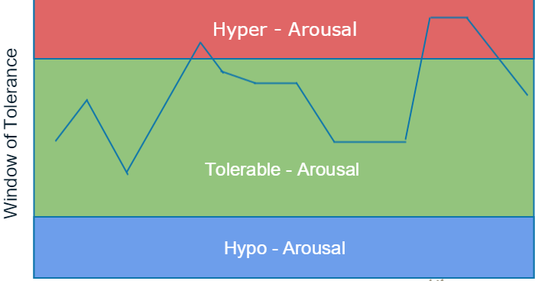
The benefits of physical activity
Mental health and emotional wellbeing
Notes:
We all have a ‘window of tolerance’, a state of mind where we are coping, the size of this window, the green area, varies person by person, some are able to cope with the most stressful situations and remain within our window of tolerance, for others it may not take too much to enter a state of arousal.
Your physical health can help grow the window of tolerance, your diet, being physically active and your sleep, which can be improved by being physically active, all contribute to your ability to cope with stressful situations.

Slide 7
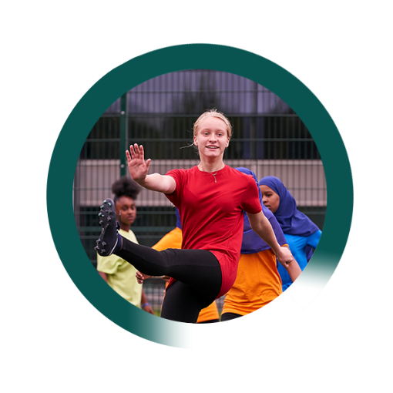
The benefits of physical activity
Physical health
Improved cardiovascular fitness
20-35% lower risk of cardiovascular disease including coronary heart disease, stroke and improved cholesterol profiles
Decreased risk of early onset type 2 diabetes
Improved bone health
Reduced body fat and maintaining a healthy weight
Stronger muscles
Promote healthy growth and development
Notes:
The physical health benefits of physical activity are probably better understood but it is worth outlining them, especially as we know there is a significant number of young people who have been sedentary through lockdown and that combined with potentially poor nutrition may have had a significant impact on their physical health, there has been a particular challenge around maintaining a healthy weight during lockdown, you may have noticed this in your pupils.
Being overweight brings about additional health risks including increased risk of diabetes, lower self-esteem and poor sleep.

Slide 8
Health & relationships curriculum
Notes:
There is an increasing awareness of the mental and physical health benefits of being physically active and they are now written into the new RSHE curriculum, which provides a fantastic opportunity to educate pupils and encourage ownership of their health as well as linking the curriculum to your PE, sport and physical activity offer in school.

Slide 9

The benefits of physical activity
Personal and social development
Improved social interaction and integration
Raised aspirations
Enhanced leadership
Improved communication skills
Positive behaviours – fairness, equality
Greater morality
Notes:
Another consequence of lockdown has been a lack of social interaction and depending on the approach within your school there may be the need to form new friendship groups and bubbles.
This is another area where physical activity may be able to help. We know that it can help promote positive behaviours, encourage team working, problem solving, interaction, learning to share and promote fairness and equality.
Allowing time to play and be active together can help accelerate children’s social development that may be behind where they would usually be.

Slide 10

Improved social interaction and integration
Raised aspirations
Enhanced leadership
Improved communication skills
Positive behaviours
Greater morality
Fundamental British Values
Fundamental British Values
Improved cardiovascular fitness
20-35% lower risk of cardiovascular disease
Decreased risk of early onset diabetes
Improved bone health
Maintaining a healthy weight
Promote healthy growth and development
Equality & Diversity
Equality & Diversity
Citizenship
Citizenship
Personal
Development
Personal
Development
Preparation for Next Stage
Preparation for Next Stage
SMSC
SMSC
Healthy
Living
Improved self-esteem
Reduced anxiety
Reduced risk of depression
Improved mood
Healthy Living
Notes:
Arguably the Personal Development aspect of the Ofsted framework is more important to young people’s development than ever, this slide lists the benefits that have been outlined in previous slides against what have been deemed to be the key aspects of a child’s personal development to demonstrate the potential of physical activity as a tool. Whether it be the opportunity presents to help young people manage develop positive social behaviours and values, manage their mental and spiritual health or to learn about healthy behaviours.

Slide 11
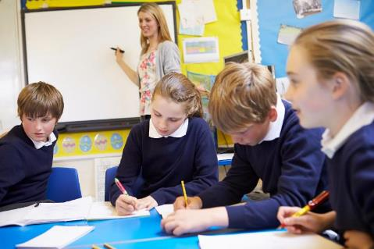
The benefits of physical activity
Academic attainment
Children and young people who are aerobically fit have higher academic scores (PHE, 2014), (Stead and Neville, 2014).
Physical activity improves factors affecting attainment including:
  Memory, concentration and perception
  Behaviour
  Attendance
  School and college satisfaction
Notes:
As well as health and social outcomes, physical activity can also enhance academic performance.
The same endorphins that make you feel better also help you concentrate and feel mentally sharp for tasks at hand. Exercise also improves concentration, motivation, memory, and perception, physical activity immediately boosts the brain’s dopamine, norepinephrine, and serotonin levels—all of which affect focus and attention.
This can improve engagement in learning, behaviour as well as the ability to learn.

Slide 12
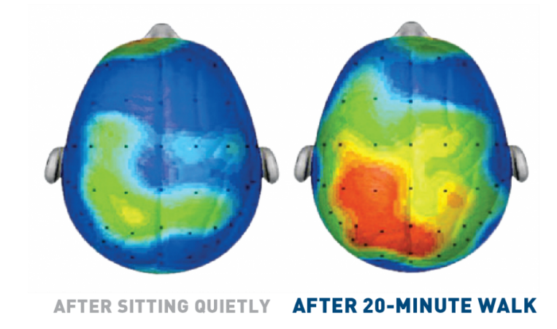
Our brains get active when we are…
Notes:
This scan shows brain activity when sedentary compared to brain activity after a 20 minute walk.
The increase in cognitive functions that activity can bring about gives young people the best chance to learn. It is worth considering where you place opportunities to be active through the day to maximise the benefits, maybe before a priority subject or challenging lesson could help?

Slide 13
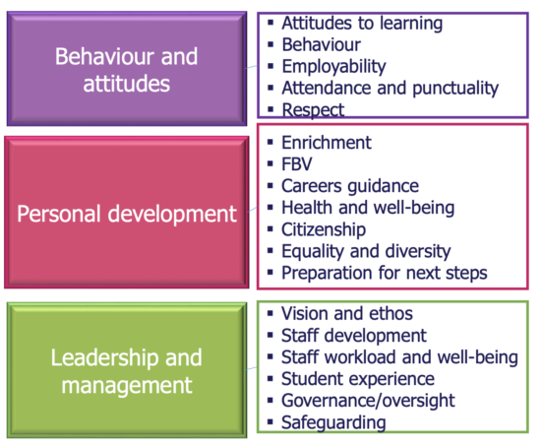
Memory, concentration, perception
Behaviour
Attendance
School and college satisfaction
Physical health
Mental health & emotional wellbeing
Social interaction and integration
Raised aspirations
Enhanced leadership
Improved communication skills
Positive behaviours
Greater morality
Planning of PESP to contribute to SIDP
Staff CPD for PE
Management of external coaches
Staff wellbeing
Governor input
Notes:
So whilst physical activity can have a significant contribution to the personal development of young people, it also has the power to impact others areas of school life including behaviours and attitudes and don’t forget that these benefits go for staff as well as pupils, we can all benefit from becoming more active to help our wellbeing and productivity.

Slide 14
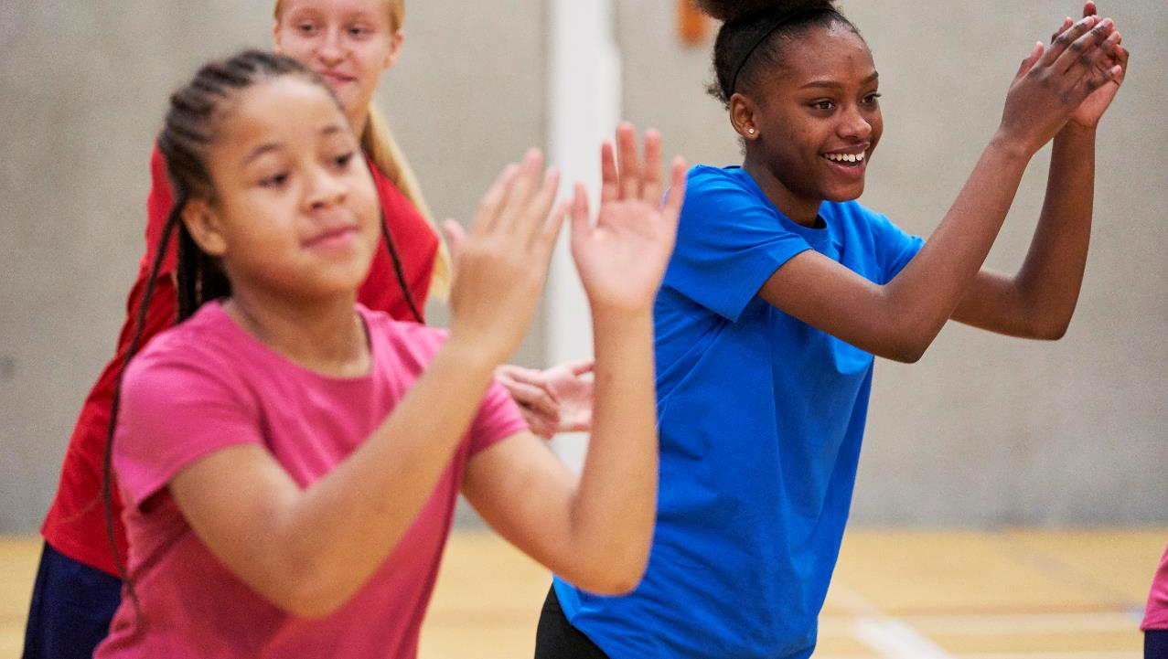
How did physical activity habits change during lockdown?

Slide 15

Activity levels were lower in lockdown
Active
Doing an average of 60mins or more of activity a day (CMO Guidelines)
Less active
Doing less than 30mins activity a day
46.8% Pre-COVID*
19% In Lockdown**
29% Pre-COVID*
43% In Lockdown**
*Source: Active Lives Child Survey data 2018/2019
** Source: COVID-19 Physical Activity Tracker (Sport England), 2020
Notes:
Worryingly, and potentially not surprisingly, activity levels of young people during lockdown were significantly lower, which is a worry given the impact of benefits of activity and impact of inactivity that have been described.
We can see that nearly half of young people used to meet the guidelines of 60 minutes activity per day, this dropped to less than 1 in 5 during lockdown
And those doing less than 30 minutes a day (and therefore considered ‘inactive’) rose from 23% to 43%.
However when you look at individual behaviours, there are interesting findings…

Slide 16
Lockdown led to unprecedented disruption & behavior change in physical activity
Source: Childrens Experience of physical activity in lockdown, Sport England (July 2020).
Interviews conducted with 1,164 7-16-year olds in May 2020
Notes:
Lockdown led to unprecedented disruption & behavior change in physical activity
We can see in these charts that broadly young people have been less active than they would have been in normal circumstances,
For some though, lockdown allowed them to be more active.
We need to consider how we sustain the habits of those who have been more active but also to help those who have been more sedentary during lockdown to rediscover activity and ensure they begin to get the benefits previously described.

Slide 17
Around 1 in 14 (7%) children aged 7 – 16 say they did nothing at all to stay active in lockdown.
Most worryingly…
Notes:
7% of our young people did nothing at all during lockdown, maybe because of a lack space, family support or shielding complications
How can you identify these young people? And how can you target support and provision to help reintroduce physical activity to begin to reverse this sedentary habit and help to begin to negate the impact this will have had on them?

Slide 18
What's contributing to lower activity levels?
Lack of access to spaces and places | Concerns about the virus
Clubs/Leisure Centres/Gyms/Classes Closed (36%) Local playground / skate park / pitch or court is closed (24%) Not at school resulting in lost opportunities to be active (36%) | Parents / carers too worried about Coronavirus to let them leave home (16%) Too worried about it themselves to leave home (14%).
“I usually ride my bike around and if its not raining I ride my bike to school, now I have nowhere to ride my bike, I used to play football with my friends in school now I can`t even see my friends”
Boy year 5 - 6
Notes:
Prior to easing of lockdown restrictions we can see that the major barriers to young people being active were a lack of access to spaces and clubs where they would normally be active, which seems intuitive but also that young people and their parents and carers are worried about the virus, this is likely to remain for some and activity, sport and PE is likely to heighten those concerns, reassurance and measures will need to be thought through and communicated to reassure families that it is safe to be active.
This slide also highlights the importance of the role you play in children’s activity habits,
• Amongst those that say that the sport and exercise they are currently doing is different to normal, over a third (36%) say they don’t have as much chance to be physically active as they are not at school
• Of those who said they aren’t doing any sport or exercise in lockdown, the data indicates that around 1/5 of those say they are “not going to school so they have less chance to be active”
We know that teen girls, less affluent children and those from Black and Asian backgrounds rely more than others on ‘at school’ provision to be active in their everyday lives
Not being at school is the key reason that young people claim they aren’t as active, you play a vital role in reintroducing activity into their daily lives.

Slide 19
Familiar inequalities but some surprising findings
Familiar Inequalities
‘Green Shoots’
Less affluent children more likely to have done nothing (13%) compared to more affluent children (6%)*
CYP from BAME backgrounds are more likely than white children to be doing more than usual*
Secondary age children (9%) more likely to say they’re doing nothing to stay active than primary age children (5%)
Girls are more likely than boys to say they are being more active than usual under lockdown (16% vs 11%) and less likely to say they are being less active than usual
(26% vs 37%)**
Children from a BAME background are twice as likely as children from a white background to say they are not doing any sport/activity in lockdown
(12% vs 6%)
Girls are more likely than boys to say they are enjoying being active more than usual (16% vs 10%)
CYP from BAME backgrounds are more likely to say they are enjoying being active more than usual
(20% vs 12% of white children)
*According to their parents/carers, Savanta ComRes activity tracker
**We cannot assume this means they are meeting CMO guidelines
Notes:
As we have seen throughout the pandemic, the effects are disproportionately worse for certain parts of the population
Less affluent children more likely to have done nothing (13%) compared to more affluent children (6%)
Children from a BAME background are twice as likely as children from a white background to say they are not doing any sport/activity in lockdown (12% vs 6%)
However, there are some interesting and encouraging green shoots that have arisen during lockdown:
CYP from BAME backgrounds were more likely than white children to be doing more than usual
Girls were more likely than boys to say they are being more active than usual under lockdown (16% vs 11%) and less likely to say they are being less active than usual (26% vs 37%)**
Girls were more likely than boys to say they are enjoying being active more than usual (16% vs 10%)
CYP from BAME backgrounds were more likely to say they are enjoying being active more than usual (20% vs 12% of white children)
This raises some important questions, what is it about physical activity during lockdown that meant usually less active groups became more active and enjoyed activity more than they normally did?
We know that barriers to being active often include judgement, competition and perceived lack of ability, maybe the freedom to be active by themselves, without judgement or competition allowed greater enjoyment. How can we take this into our provision in future?

Slide 20
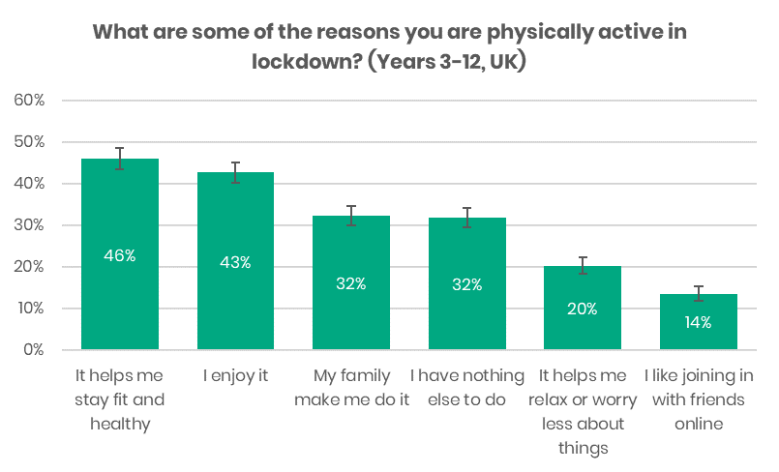
There are reasons to be cheerful
“
Nearly 7 in 10 are exercising for the benefits (stay fit, enjoyment, helps me relax, join friends)
Enjoyment continues to play a key role
Parents/carers are great role models:
21% are being more active with their family than usual
71% are being active with their parents/carers and 51% with a sibling
The more active a parent is, the more active their children are.
Notes:
There are some really positive findings about the role families are playing. The majority of kids (around 7 in 10) are being active with their families, and we know that the more active a parent is, the more active their child is.
If the parent/carer enjoys sport and physical activity, feels they have the ability to be physically active and/or feels they have the opportunity to be active, the child is more likely to be active and more likely to be doing more compared to pre lockdown.
This is, of course, out of a school’ control and not something that is easily influenced but have you considered what messaging goes home about activity, what a child has done, enjoyed, opportunities in the community to continue to be active?

Slide 21
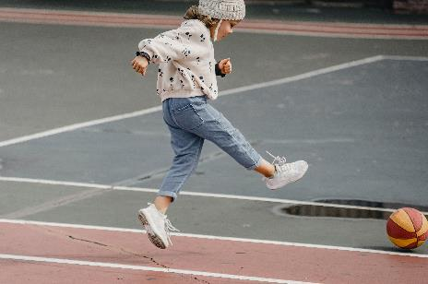
Notes:
This chart demonstrates that while activity reduced broadly, walking and cycling increased. Green bars are during lockdown and blue are pre-lockdown.
‘Going for a walk’ has substituted many of the usual activity types for this age range, becoming by far the most prevalent way to stay active in lockdown. More than twice as many children are going for walks, compared to those who said they went for a walk in the last week during 2018-19.
Given 71% of these young respondents say they are being active with their parents/carers, it’s likely that the majority of those walks are taken as a family. The only other type of activity that seems more prevalent than usual is going for a bike or scooter ride (39%). Walking is also the one activity that is not affected by affluence
This introduces a significant opportunity to create a shift in how we travel, active travel is not only a fantastic way to embed physically activity into our day but is also positive environmentally and creates much safer school sites during drop-off and pick up.
Are you promoting active travel? Is this something that could be a greater focus to capitalise on this unprecedented opportunity to change behaviours?
We know there are significant barriers to embedding active travel to and from schools but there are resources out there to help overcome some of these, if you are interested in a further conversation about active travel, please do get in touch.

Slide 22
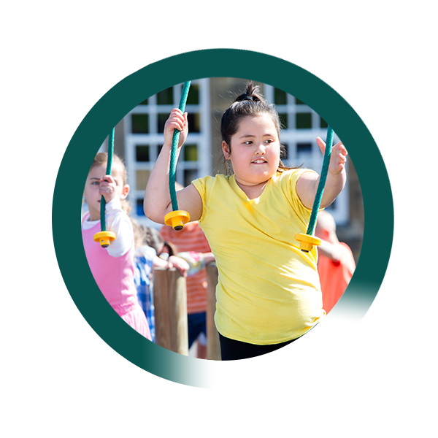
Summary and Implications
Physical activity is a tool that can contribute to improving outcomes affected by lockdown.
On the whole, young people have been less active during lockdown
However, there are green shoots, we need to consider how we keep up the habits of those who have increased their levels and keep families walking and cycling.
Whilst targeting those who have been inactive and who can benefit most from increasing their activity levels.
Notes:
To summarise:
Physical activity is a tool that can contribute to improving outcomes affected by lockdown.
On the whole, young people have been less active during lockdown
However, there are green shoots, we need to consider how we keep up the habits of those who have increased their levels and keep families walking and cycling.
Whilst targeting those who have been inactive and who can benefit most from increasing their activity levels.

Slide 23
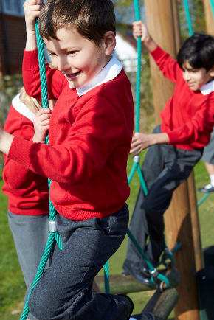
Get in touch
Stephen Hulme
stephen.hulme@activenorfolk.org
Jo Thompson
joanne.thompson@activenorfolk.org
01603 732381
https://www.activenorfolk.org/pe-sport-premium
Notes:
Please contact Active Norfolk for more information.
Please now move on to module 2 where we’ll update on the PE and Sports Premium.

Slide 24
PE and Sport Premium
Guidance 2020-21
Module 2 of 3
Notes:
Welcome to module 2 of 3 where we will outline the PE & Sport Premium guidance for this year

Slide 25
Modules Overview
Module 1
‘How can physical activity, PE & school sport help pupils overcome the impacts of lockdown?’
Why improve your provision? (The benefits of physical activity)
Module 2
‘PE & Sport Premium Guidance 2020-21’
What are the conditions of the grant? (Updated grant guidance)
Module 3
‘Let’s rethink your PE & Sport Premium to achieve the best outcomes for pupils’
How can we maximise the benefits of physical activity in school?
Notes:
In Module 1 you would’ve heard in depth the benefits of physical activity and how it can be used to tackle some of the difficulties we are currently facing.
It is important to keep that information in mind when we now look at the updated PE & Sport Premium guidance.

Slide 26

Objectives
Be well informed of the purpose of the PE & Sport premium and the relevant updates
Understand the potential breadth of use of the premium
Understand the accountability measures, statutory duties and the funded support that is available
Notes:
The objectives of this module 2 are to;
Be well informed of the purpose of the PE & Sport premium and the relevant updates
Understand the potential breadth of use of the premium
Understand the accountability measures, statutory duties and the funded support that is available

Slide 27
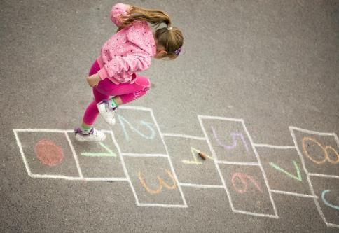
Why listen to Active Norfolk?
One of 43 Active Partnerships
Strategic lead for sport and physical activity
Funded (mainly) by Sport England
Hosted by Norfolk County Council
Work across sectors
Have a funded role to support schools
Notes:
If you haven’t already heard of us, we are Active Norfolk and we are one of 43 Active Partnerships in the country, each county has a team like us.
We are the strategic lead for sport and physical activity. We are funded (mainly) by Sport England, are hosted by Norfolk County Council and work across sectors to help embed physical activity in people’s lives for health, economic and social outcomes.
But most significantly we have an impartial, fully funded role to support schools to maximise their PE & Sport Premium Funding. We don’t judge, make decisions or tell schools what to do. We simply support schools through a process to enable their funding to make the biggest difference where it’s needed the most.

Slide 28
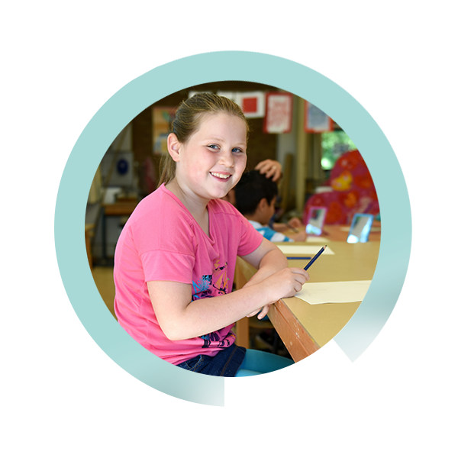
We advocate the benefits of physical activity with:
School Improvement Partners
Governor Services
Trusts, MATs
Children’s Services; Early Years, Virtual School for SEND, Home Educators, Alternative Providers,
Norfolk County Council; Family Learners, Community Focus Teams, Norfolk Safeguarding Children Partnership
Notes:
We work with lots of partners and organisations, listed here, to help increase their knowledge of the benefits of physical activity and how this can be used to help them achieve their outcomes. Our mission is to ensure physical activity is doing its bit to improve the health, happiness and prospects of our county’s children. Your funding decisions can support this and help us give our young people the best start.

Slide 29
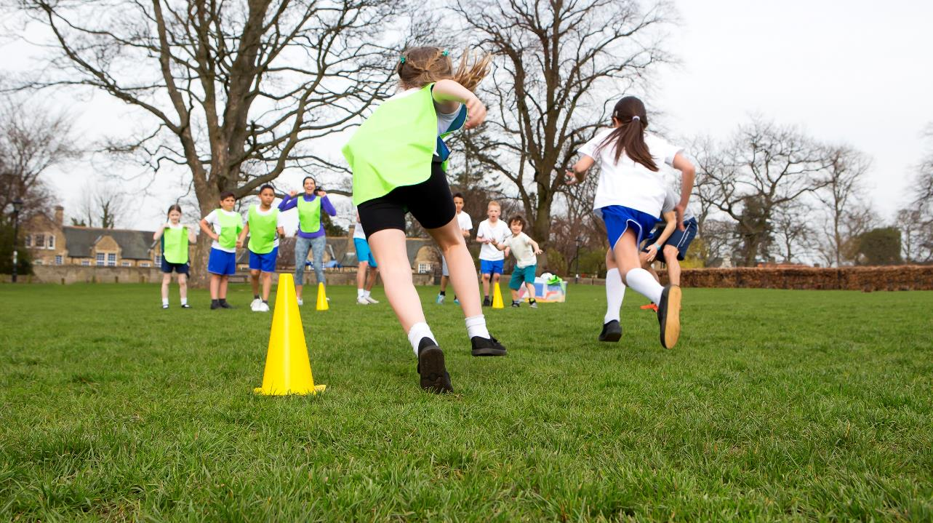
PE and Sport Premium is here for the next year and still has a terrible name…
Ignore it.
Especially now!
Notes:
The Pe and sport premium is here for the next academic year and still has a terrible name…Especially now!
This funding is primarily a health intervention, . This means a large portion of the funding comes from the Department of Health and money raised by the sugar levy so we should be considering if, how and to what extent our spend is focussed on improving the health of pupils. And for lots of our youngsters this issue sits OUTSIDE the PE curriculum. Although PE is the area of provision that all children get access to, its where, for lots of young people, their relationship with physical activity starts. If you can confidently say (and evidence) that your school’s pe provision is good or outstanding for ALL pupils then your funding does not need to be spent on improving it. It can, be spent elsewhere.
So please ignore the name and think of it in its broader sense. How can this funding be used creatively to achieve your priority outcomes, using physical activity as a tool.
This is the best time to use the funding to try something new, to meet a new need, to prioritise wellbeing and have the biggest, sustainable impact as all your pupils may now have different lifestyles, habits, outlooks, experiences and needs.

Slide 30
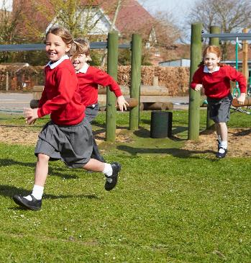
PE & SP Updates for 2020-21
The funding is confirmed for 2020-21
Underspend from 2019-20 can be carry forward (but needs to be included within the website reporting)
Emphasis on sustainability
Well-being a priority
Still must consider the 5 key indicators
Swimming must still be reported where there is data available
Notes:
In June, the DfE confirmed the funding will continue for this academic year.
It also stated that any underspend from last year can be carried forward but does need to be shown within the website reporting.
There is also a further emphasis on demonstrating sustainability of each area of the spend.
Well-being is being highlighted as a priority. This is good news as it supports schools to be creative with the funding and target the needs of their pupils differently.
Schools must still consider the 5 key indicators of the funding with each area of the spend.
Swimming must still be reported on the website where there is data available.

Slide 31
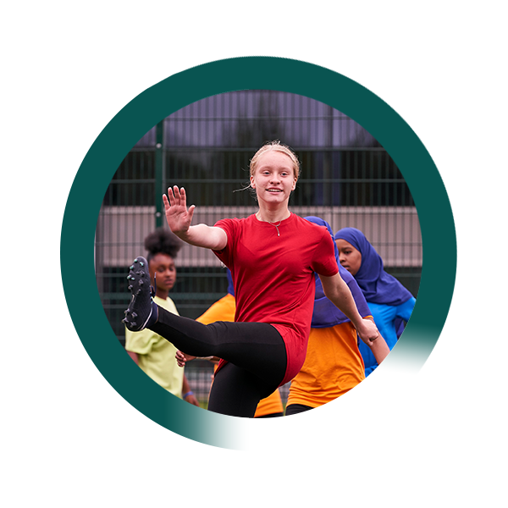
Improving activity levels gives our pupils:
In the SHORT TERM -
The best chance to LEARN
In the LONG TERM -
Better LIFE Outcomes
Notes:
So just a reminder, as we described in module 1, that this funding can help give our pupils the best chance to learn and better life outcomes. We need all our staff and deliverers to know and understand this and to bear this in mind when deciding where our funding is going.

Slide 32
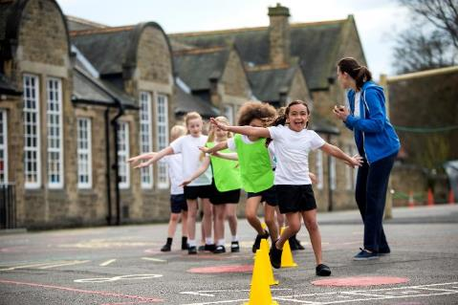
The benefits of physical activity
Mental health and emotional wellbeing
Physical health
Personal and social development
Academic attainment
(explored in depth in module 1)
Notes:
This isn’t new! You would’ve heard all about the benefits in module 1.
But it is even more relevant given the current climate for our young people and how all these areas for them have been affected significantly over recent times.
Think of the children that are having difficulties in any of these areas. Could improving their activity help? This funding can support the interventions that may help them tackle some of these areas. It’s certainly worth a try!
Do all of the staff in school recognize when children have difficulties with some of these? And do they consider where physical activity can be the tool that can help? We all know children that spring to mind when we think of these concerns. Do we know what their lifestyle is like? Can we help them tackle some of these things by supporting them to improve their lifestyle? If so, we have the funding to do it with!

Slide 33
Purpose of Funding
The premium must be used to fund additional and sustainable improvements to the provision of PE and sport, for the benefit of primary-aged pupils, to encourage the development of healthy, active lifestyles.
The Vision
“All pupils leaving primary school physically literate and with the knowledge, skills and motivation necessary to equip them for a healthy lifestyle and lifelong participation in physical activity and sport.”
Education Secretary Gavin Williamson, said:
“During these challenging times, it has become clearer to me than ever the importance of keeping active and how it benefits not just our physical health but also our ability to pay attention, our mood and our mental health too.”
Notes:
This is the wording of the guidance from the DfE.
The premium must be used to fund additional and sustainable improvements to the provision of PE and sport, for the benefit of primary-aged pupils, to encourage the development of healthy, active lifestyles.
The vision states;
“All pupils leaving primary school physically literate and with the knowledge, skills and motivation necessary to equip them for a healthy lifestyle and lifelong participation in physical activity and sport.”
Education Secretary Gavin Williamson, recently said:
“During these challenging times, it has become clearer to me than ever the importance of keeping active and how it benefits not just our physical health but also our ability to pay attention, our mood and our mental health too.”
The recent update states that the original purpose and vision of the funding continues to apply, but schools are being urged to use the funding flexibly whilst still continuing to support at least one of the key indicators with each area of spend.
The grant conditions still apply.

Slide 34
5 key indicators that schools should expect to see improvement across:
The engagement of all pupils in regular physical activity – the Chief Medical Officer guidelines recommend that all children and young people aged 5 to 18 engage in at least 60 minutes of physical activity a day, of which 30 minutes should be in school
The profile of PE and sport is raised across the school as a tool for whole-school Improvement
Increased confidence, knowledge and skills of all staff in teaching PE and sport
Broader experience of a range of sports and activities offered to all pupils
Increased participation in competitive sport
Notes:
These are the 5 key indicators that schools should expect to see improvement across:
1. The engagement of all pupils in regular physical activity –
the Chief Medical Officer guidelines recommend that all children and young people aged 5 to 18 engage in at least 60 minutes of physical activity a day, of which 30 minutes should be in school
This can be by providing targeted activities or support for the least active children, encouraging active play and active learning, broadening the variety of activities offered to appeal to different pupils, adopting a daily activity initiative, for example, the daily mile, raising attainment in swimming.
2. The profile of PE and sport is raised across the school as a tool for whole-school Improvement. For example embedding a leadership programme within school, improving opportunities for active travel, improving physical activity levels within the all lessons by involving all whole staff in cpd.
3. Increased confidence, knowledge and skills of all staff in teaching PE and sport and their understanding of the benefits of increased physical activity levels. Enabling all pupils to access high quality provision from all deliverers. This is a good way of the spend being sustainable.
4. Broader experience of a range of sports and activities offered to all pupils. This can be done by introducing new activities and sports, consulting with the pupils to find out what would engage them, developing the extra-curricular offer to meet the needs of all pupils.
5. Increased participation in competitive sport including widening the reach of programmes like the School Games so that more pupils get to experience the offer.

Slide 35
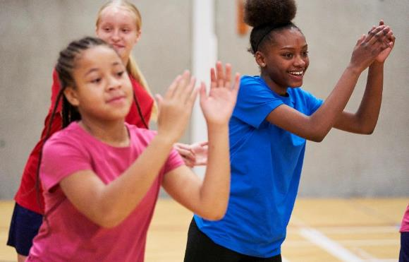
The funding should be used to:
Develop or add to the PE, physical activity and sport that your school provides.
Build capacity and capability within the school to ensure that improvements made now will benefit pupils joining the school in future years.
Notes:
The funding should be used to;
Develop or add to the PE, physical activity and sport that your school provides.
Build capacity and capability within the school to ensure that improvements made now will benefit pupils joining the school in the future years
This is going to be different to how schools have tackled this before. Current restrictions and guidelines are going to have an impact on what this looks like in schools. But this is still part of the grant conditions and so time and consideration to develop provision accordingly should still be spent in order to be effective. We encourage schools to revise their planned funding. This is explored further in module 3.

Slide 36
You should not use your funding to:
Employ coaches or specialist teachers to cover PPA arrangements - these should come out of your core staffing budgets
Teach the minimum requirements of the national curriculum – with the exception of top-up swimming lessons after pupils’ completion of core lessons (or, in the case of academies and free schools, to teach your existing PE curriculum)
Fund capital expenditure - the Department for Education does not set the capitalisation policy for each school. School business managers, school accountants and their auditors are best placed to advise on a school’s agreed capitalisation policy
Notes:
Schools should not use their funding to;
Employ coaches or specialist teachers to cover PPA arrangements - these should come out of your core staffing budgets
Teach the minimum requirements of the national curriculum – with the exception of top-up swimming lessons after pupils’ completion of core lessons (or, in the case of academies and free schools, to teach your existing PE curriculum)
Fund capital expenditure – we are often asked what constitutes capital spend, the Department for Education’s response to this question is that the DfE does not set the capitalisation policy for each school. School business managers, school accountants and their auditors are best placed to advise on a school’s agreed capitalisation policy
Website reporting should be transparent and demonstrate clearly where the funding is going. Within our role we have a responsibility to review norfolk schools website reports in a non-judgemental way to help understand where the 6 million pounds a year that is coming into our county is being spent. We can support schools on how to keep to these conditions of the grant.

Slide 37
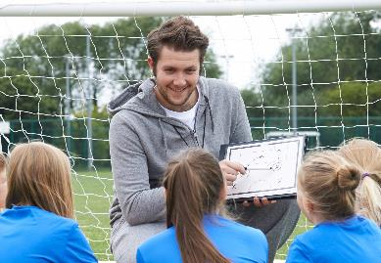
Using coaches in schools:
Deploy coaches within your policies
Coaches can offer skills, knowledge and experience where there is an identified gap.
Coaches should not replace teachers - this is not sustainable
Ensure the coach and teacher work together to increase the teacher’s knowledge
Set a timeline for the coach to upskill the teacher
PESP cannot be used for PPA
What skills/knowledge gaps are you filling? What outcomes are you looking to achieve?
Notes:
Coaches can be a fantastic resource offering skills, knowledge and experience where there is an identified gap but there are considerations when you are deploying external providers
First off, ensure that any external providers are deployed safely, considering how they interact with staff and pupils in your school and also whether they coach outside of your school and in community settings, what is your policy on this?
Be clear about what skills gaps you are filling through an external provider
Coaches should not replace teachers - this is not effective or sustainable. Coaches and teachers have very different skills and knowledge that can be complimentary but a coach isn’t trained to do the job of a teacher. Also, consider if the funding stops tomorrow, how would you pay for the coach? If you couldn’t what would happen to the quality of your practice and the skills/knowledge of school staff?
Coach and teacher working together can be very powerful, if the coach is working to upskill a teacher set a timeline, this should not be an indefinite arrangement
The PE and Sport Premium cannot be used to cover PPA
Maintain ownership of your outcomes and set them with the coach/provider, you remain responsible for delivery and outcomes.

Slide 38
Using coaches in schools:
Get the right coach
Recruit/induct/manage and monitor coaches the same way you would a teacher
Consider the appropriate qualifications
Maintain ownership of your outcomes
Schools maintain duty of care and coaches will be observed by Ofsted/senior leaders as a teacher would.
Coaches can be fantastic assets when employed and deployed properly!
Download the Guide to Using Coaches in Schools
Notes:
Remember to get the most out of your funding you need to;
Get the right coach that fits your values and outcomes and is right for your school
Recruit/induct/manage and monitor coaches the same way you would any other member of staff
Consider the appropriate qualifications for what you are asking them to do, someone coaching a football team will need very different skills than someone looking to engage your inactive pupils through a fun play session.
Maintain ownership of your outcomes and ensure this is in agreement with the coach from the offset
maintain duty of care and remember coaches are expected be observed by Ofsted/senior leaders as any teacher would.
Coaches can be fantastic assets when employed and deployed properly, a guide is available at the link on the slide to help effectively deploy external coaches and providers, it should be noted that this was written prior to covid-19.

Slide 39
Planning PE & Sport Premium Spend:
Ensuring all staff understand and contribute to the PE & SP
Involving all stakeholders (governors, pupils etc)
Interventions and activities should relate to the outcome
Allowing ideas to be flexible and creative – take risks
Notes:
Planning your spend is explored in detail in module 3 but these are the basic principles to consider;
Ensure all staff understand and contribute to the PE & Sport premium plan
Involve all stakeholders (governors, pupils etc)
Interventions and activities should relate to the outcome. Be clear about the outcomes you want to achieve and ensure the intervention put in place is appropriate to achieve this. How do you know it will and has made a difference and what evidence do you have to support this?
Allow ideas to be flexible and creative – take risks, this funding gives you a chance to try new strategies and ideas.

Slide 40
Swimming
The Premium can be used to fund the professional development and training that are available to schools to train staff to support high quality swimming and water safety lessons for their pupils.
The Premium may also be used to provide additional top-up swimming lessons to pupils who have not been able to meet the national curriculum requirements for swimming and water safety after the delivery of core swimming and water safety lessons. At the end of key stage 2 all pupils are expected to be able to swim confidently and know how to be safe in and around water.
Schools are required to publish information on the percentage of their pupils in year 6 who met each of the 3 swimming and water safety national curriculum requirements.
N.B. There is currently still the expectation that reporting swimming data for 2020-21 will be expected
Notes:
Swimming
The premium can be used to fund the professional development and training that are available to schools to train staff to support high quality swimming and water safety lessons for their pupils.
The premium may also be used to provide additional top-up swimming lessons to pupils who have not been able to meet the national curriculum requirements for swimming and water safety after the delivery of core swimming and water safety lessons. At the end of key stage 2 all pupils are expected to be able to swim confidently and know how to be safe in and around water.
Schools are required to publish information on the percentage of their pupils in year 6 who met each of the 3 swimming and water safety national curriculum requirements. Even if data from 2019-20 is not available due to school closures please be reminded that reporting this on your website is still required. Schools should state the data they do have or the reason for no data being available.
There is currently still the expectation that reporting swimming data for 2020-21 will be expected so please plan to reintroduce swimming during the year as guidelines allow.

Slide 41
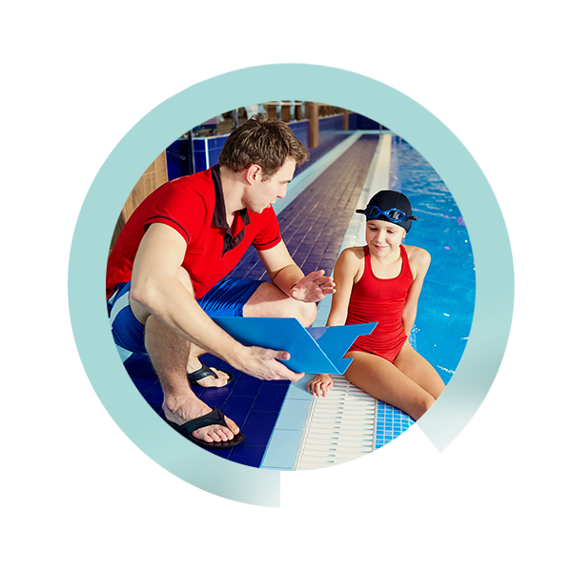
Accountability
Website reporting (complete by 31st July 2020)
Ofsted
The new RSHE curriculum
School Governance
CMO Guidelines
Government Childhood Obesity Strategy
Our Desire to do the best for young people
Notes:
Schools have been given the funding directly and therefore trusted to make the right decisions for pupils so we need to maximise the impact. Like other areas of school, there are also some measures in place to check that.
Your Website reporting needs to have been complete by 31st July.
The new Ofsted framework includes personal development and many other areas that can be met by increasing physical activity levels
The new RSHE curriculum now includes much more comprehensive areas around health and well being
Your School Governing Body should be questioning and monitoring the impact of the spend. Active Norfolk can support school governors to do this too.
The Chief Medical Officer recommendation for young peoples activity levels. There is an ambition that young people do 30 minutes of their 60 active minutes a day at school.
The Government Childhood Obesity Strategy, updated 2018 includes the role schools should play in help tackling the national challenge
Our Conscience – are we getting the best outcomes with this funding?

Slide 42
Website reporting should include:
The amount of Premium received
A full breakdown of how it has been spent (or will be spent)
Any underspend that is to be carried forward
What impact the school has seen on pupils’ PE and sport participation and attainment
How the improvements will be sustainable in the future
How many pupils within their year 6 cohort can do each of the following:
  Swim competently, confidently and proficiently over a distance of at least 25 metres
  Use a range of strokes effectively
  Perform safe self-rescue in different water-based situations
  (if this data is not available then a statement making this clear should be included in the website report)
Notes:
Website reporting should include:
the amount of premium received
a full breakdown of how it has been spent (or will be spent)
Any underspend that is going to be carried forward
what impact the school has seen on pupils’ PE and sport participation and attainment
how the improvements will be sustainable in the future
how many pupils within their year 6 cohort can achieve the swimming outcomes listed here.

Slide 43

Best practice website reporting:
SIDP links
Previous years reports
% of funding allocated
Anecdotal evidence
Photos
http://www.afpe.org.uk/physical-education/evidencing-the-impact-guidance-template/
Notes:
We would also encourage you to include;
School Improvement and Development Plan links
Previous years reports
% of funding allocated for each area
Anecdotal evidence
Photos
You can find the recommended template following the link on this slide

Slide 44
Summary
Physical activity is a tool that can help improve wider outcomes and priorities
The PE and Sport Premium (ignore the name) is ring-fenced funding to help you to do that
Make the Premium work for your school and your pupils with good planning and creativity
Notes:
To summarise;
Physical activity is a tool that can help improve wider outcomes and priorities
The PE and Sport Premium (ignore the name) is ring-fenced funding to help you to do that
Make the premium work for your school and your pupils, especially at this challenging time with good planning and creativity
Now Move on to Module 3
‘Let’s rethink your PE & Sport Premium to achieve the best outcomes for pupils’

Slide 45
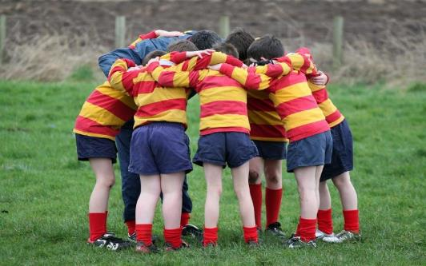
Support available through Active Norfolk:
Workshops and CPD
Guides and resources
1:1 support
Active Lives Survey
N.B all support is available virtually
Notes:
Remember the role that Active Norfolk can play, please feel free to get in touch with us for support around your PE and Sports Premium

Slide 46

Get in touch
Stephen Hulme
stephen.hulme@activenorfolk.org
Jo Thompson
joanne.thompson@activenorfolk.org
01603 732381
https://www.activenorfolk.org/pe-sport-premium

Slide 47
Let’s rethink your PE and Sport Premium to achieve the best outcomes for your pupils
Module 3 of 3
Notes:
Welcome to module 3.
Having completed modules 1 & 2 we’ll now begin to think about rethinking your PE & Sport Premium funding to achieve the best outcomes for your pupils.

Slide 48
Modules Overview
Module 1
‘How can physical activity, PE & school sport help pupils overcome the impacts of lockdown?’
Why improve your provision? (The benefits of physical activity)
Module 2
‘PE & Sport Premium Guidance 2020-21’
What are the conditions of the grant? (Updated grant guidance)
Module 3
‘Let’s rethink your PE & Sport Premium to achieve the best outcomes for pupils’
How can we maximise the benefits of physical activity in school?
Notes:
In the first two modules we have seen that physical activity is a tool that can help a broad range of outcomes in a school, from improving mental and physical health, promoting positive social behaviours and improving education outcomes. We also learned that the PE and Sport Premium is ringfenced funding to help realise these benefits through physical activity.
So now Module 3
‘Let’s rethink your PE & Sport Premium to achieve the best outcomes for pupils’
We will explore how can we get the most out of our funding and maximise the impact of physical activity in school.

Slide 49

Objectives of this module
Understand the potential breadth of use of the PE and Sports Premium
Question our previous decisions
How to plan for using the Premium to maximise the impact
Understand the accountability measures, statutory duties and the funded support that is available
Notes:
The objectives of this module are to;
Understand the potential breadth of use of the premium
Exploring broader and different uses for the premium
Question our previous decisions
Lets think about how doing things differently can improve and change the impact we see in order to get the most from our funding.
How to plan for using the funding to maximise the impact.
where do we start and what information do we need in order to know what to do next?
Understand the accountability measures, statutory duties and the funded support that is available

Slide 50
Why listen to Active Norfolk?
One of 43 Active Partnerships
Strategic lead for sport and physical activity
Funded (mainly) by Sport England
Hosted by Norfolk County Council
Work across sectors
Have a funded role to support schools
Notes:
This is just a reminder of our role and who we are.
Remember we have an impartial, fully funded role to support schools to maximise their PE & Sport Premium Funding. We don’t judge, make decisions or tell schools what to do. We simply support schools through a process to enable their funding to make the biggest difference where it’s needed the most.
You can contact us at any time for any support.

Slide 51
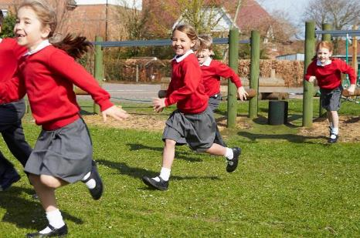
We advocate the benefits of physical activity with:
School Improvement Partners
Governor Services
Trusts, MATs
Children’s Services; Early Years, Virtual School for SEND, Home Educators, Alternative Providers,
Norfolk County Council; Family Learners, Community Focus Teams, Norfolk Safeguarding Children Partnership
Notes:
We work in partnership with number of organisations who work with and support your school to ensure collective and consistent messaging around physical activity in schools. Much of the sector are starting to understand the benefits of physical activity and how it can contribute to improved outcomes for young people. These organisations may make reference to where physical activity can be used which could help you identify where your provision could be targeted.

Slide 52
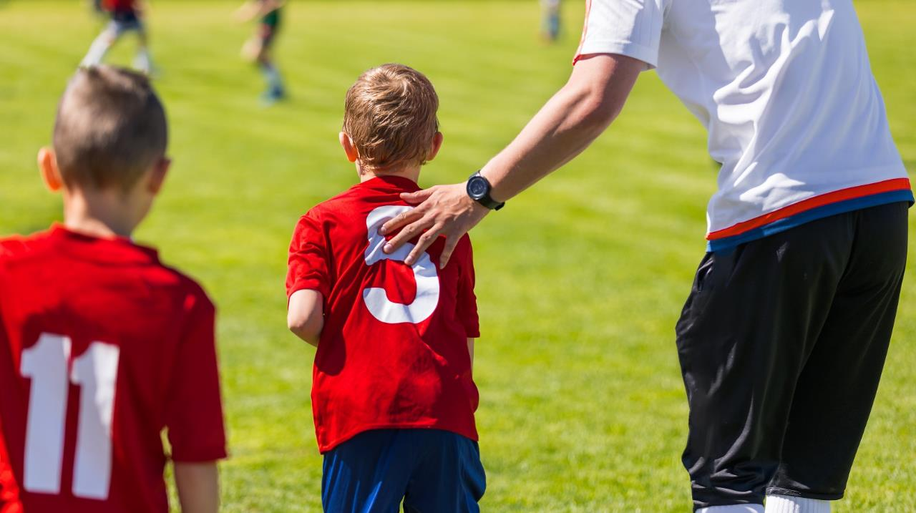
PE and Sport Premium is still a terrible name…ignore it
Especially now!
Notes:
The name leads us to focus on curriculum and clubs, these remain important but now more than ever it is important to be considering how the funding is used to;
Meet a new need –pupils needs are likely to be different given the impact of lockdown and face new challenges and circumstances. Try something new – adapting your provision and being creative to meet new needs
Prioritise wellbeing – lets use this funding to help get our pupils back to being active, healthy and confident
These things will all help us achieve appropriate and far reaching outcomes for the current circumstances.
So now we need to pause and reconsider our approach in order to make a change

Slide 53
Review,
Reconsider,
and then Redesign
Notes:
The remainder of this session will be structured to help you to:
Review what you’ve done previously
Reconsider what you are trying to achieve
And then redesign your new approach

Slide 54
Review
Consider your previous approach:
  What successful or unsuccessful interventions have been used in the past?
  Were the outcomes you were trying to achieve clear?
  Were the outcomes the most pertinent to your school i.e. linked to your SIDP?
  How do you know how successful they were?
  How are you monitoring and reviewing impact?
Don’t do the same thing just because its what you’ve always done
Notes:
Firstly, there are questions we need to ask about how we’ve spent our funding previously.
Take a look at your previous plans and be really honest with how well the interventions and approaches went.
What were you trying to achieve? Did they achieve the planned outcome and how do you know? Do you know what made them work or not? Why did you do them? What difference did they make?
Where and how did they contribute towards the whole school improvement plan? And what did monitoring and reviewing the spend look like previously?
Be ruthless and honest in challenging previous practice, this will help you to be constructive. To maximise this funding any previous area of spend does not need to be repeated if it is unlikely to achieve the desired outcomes and meet the needs of our pupils now

Slide 55

Review
Association for Physical Education impact template
https://www.afpe.org.uk/physical-education/evidencing-the-impact-guidance-template
Notes:
The Association for Physical Education have designed a template with national partners and is the recommended format in which to develop and present your plan, it can help you identify some of the answers to the questions posed in the previous slide.
It helps you see the intentions;
clarity on intended impact on pupils:
Actions to achieve:
Funding allocated:
Evidence and impact:
Sustainability and suggested next steps:
This is especially useful if there were different people involved in the decisions in previous plans.

Slide 56
Reconsider
Reconsider what you are trying to achieve
Take learnings from our review process
Use insight to know where to target our spend
Look at your SIDP
Get everyone in school involved
Refresh your thinking
Be clear about your outcomes before you write your plan
Notes:
We need to reconsider what we want to achieve with the premium with the current circumstances in mind and that will direct where our funding is best spent.
We need to be prepared to explore possibilities that we haven’t previously considered and learn how new approaches can benefit our pupils now.
You’ve now got the answers to your review process as a starting point. Let previous learnings inform your new plan.
Next, let’s look at the needs of the pupils. What does your school improvement plan say are your whole school priorities? What are your post-lockdown priorities? Have you seen a deterioration in mental health or more pupils that are overweight? And where can this funding help? Remember the breadth of outcomes that physical activity can contribute towards outlined in module 1, from improving mental and physical health, promoting positive social behaviours and improving education outcomes. Do you have priority cohorts in your school? Priority subjects? Or priority themes such as improving behavior, attendance or wellbeing? Physical activity and therefore the PE and Sports Premium can contribute to improvements in all of these, we will outline some examples of how this could be achieved in the redesign section.
It is important at this point that you utilize all available insight in your school to identify your outcomes, talk to all the stakeholders, staff and pupils, to find out where your focus should be. Staff working in individual bubbles are well placed to identify priority pupils that would benefit from increasing their physical activity levels. Often other specialists in school can help identify specific need, the SENDco and RSHE Co-Ordinator could provide valuable insight on which vulnerable children could benefit from increased physical activity level, What their barriers are and how have their lifestyles changed over recent months. It may be worth sharing the benefits of physical activity from module 1 with other staff to ensure they understand how the premium can help.
These steps will help you to be clear about what you want PE, sport, physical activity and the premium to achieve in your schools, you are then ready to begin to redesign your approach to help achieve these identified outcomes.

Slide 57

Redesign
Start a new plan to achieve the outcomes you have just identified
Consider your universal offer including PE curriculum
Identify opportunities to introduce physical activity through the day
Be creative in tackling identified challenges
Consider active travel and family support
Notes:
Now you are clear about what you want to achieve we’re ready to start designing a new plan considering:
Your curriculum and universal offer to all pupils
Prioritising target groups, introducing creative ideas to help tackle their challenges.
Ideas that increase the opportunity to be physically active throughout the school day to help achieve your identified outcomes
And lets consider other opportunities like how our pupils travel to and from school (does our school environment support active travel?) and whether engaging our families could help help.
To keep this useful to as many of you as possible we will run through some broad considerations and tips that can help when redesigning your approach based on these areas, however, we are aware you may have specific issues in your school, Active Norfolk can help by sharing case studies from other schools that have faced similar challenges. If you need help on creative ways to tackle specific challenges then get in touch.

Slide 58
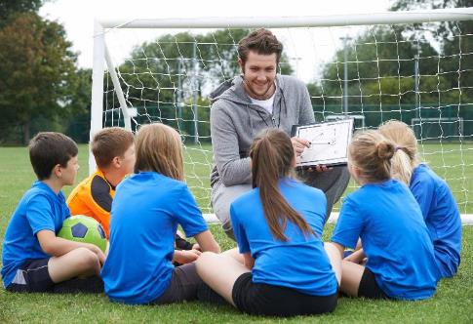
Your Universal Offer
How successful is your physical education offer? How do you know?
How confident are your staff in delivering PE?
What are the opportunities for all pupils to be active through the day?
Notes:
Consider your universal offer, opportunities available to all pupils to be active
All pupils have the opportunity to take part in PE every week. For many children this is where their experience of physical activity starts. It can also be the place they form an opinion and expectations of themselves physically. It can be the reason they decide to continue to be active, or not. If any child’s experiences of pe is negative then that may be where you could focus some input. A staff skills audit and regular monitoring of delivery could help, especially considering staff bubble arrangements and the need for a consistent outstanding curriculum offer across the school. But if all your pupil’s curriculum needs are being met then maybe the funding does not need to be spent in this area. It could be spent elsewhere to have the maximum impact.
Outside the pe curriculum is where most pupils physical activity levels could increase. Bear in mind the Chief Medical Officers recommendations of at least 60 minutes a day on average over a week for children aged 5 to 18 years old, with schools being challenged to offer 30 minutes a day towards this target. What does that look like for your pupils and where could increases be made? Are classrooms sedentary? Are activity breaks and daily activity common place and consistent across the school? If this is an area of priority then how can this funding help improve things?
Depending on the outcomes you have identified for your new plan, you could consider utilizing physical activity by deploying it strategically through the day and week.

Slide 59
How can I practically maximise benefits in the school day and week?
Put physical activity where it can benefit most:
  At challenging times of the day
  During priority subjects
  Active breaks
  For targeted young people
  At a difficult time of year
  Timetabling
Support young people into community activity
Notes:
Here are some examples of how you might use physical activity through the day:
Using physical activity at challenging times of the day – Do you have particular times of the day where there are issues? For instance behavior at lunchtime or energy levels in the final lesson of the day? For some children the beginning part of the day can be a struggle, how they transition from their home setting into school can be their challenge. Could adding a burst of activity help with any of these?
During priority subjects - Some children engage with learning better in some subjects than others. Could introducing more physical activity to areas of difficulty help? For example, if maths is a whole-school priority then where are the physical aspects of the lesson that could help engage children who usually find maths difficult. Could maths be timetabled after an active break to help concentration and maximise readiness to learn? There are also subject specific curriculum resources to help make lessons active such as Maths of the Day and Active English.
Active breaks can be used to help improve learning too. Injecting some activity to break up sedentary behavior can make a significant difference. For example a specialist behaviour setting have used some of their premium to fund trampettes for outside of classrooms, this allowed pupils to access short bursts of activity at times that suited their behaviour needs. Do all staff know how to include opportunity for physical activity within their planning? Another example of this is when asking the class a question, could answers be demonstrated using physical actions, a squat for ‘yes’ or a one foot balance for ‘no’. Or a whole class, regular 5 minute activity break can be introduced effectively. These ideas are suitable to support working in bubbles with children still staying in their allocated space in the classroom. Its also important that young people take the opportunity of break times and lunchtime to be active, getting those benefits between lesson times.
For targeted young people - You will know the young people who could benefit most from becoming more active, you can target those young people with your funding. For example it could be a priority class, those who don’t engage in PE or those who may be overweight. When considering specific children to target explore how additional staff time can be used. A really good example of where this has worked well is where the pe and sport premium funding was used to increase support staff hours. The staff had the specific task, within these few, additional hours, of getting targeted children active at set times of the day. It was added to their timetable. The school saw improvement in the learners positivity, interest and productivity in the lessons that followed their allocated physical activity time.
At a difficult time of year – If you have a particular challenge at some point in your year, for example emotional wellbeing during SATs you could use your premium for intervention, we have seen many schools successfully use yoga and mindfulness exercises during times of stress for young people.
Timetabling – as well as placing activity prior to priority subjects you could also consider how PE and sport could be used to encourage those sporty kids. Maybe you have pupils who love PE and sport but are less confident in other areas of their development, could timetabling PE or putting on a popular club on the same day as a more challenging subject help them to engage?
Remember all these positive activity experiences are going to help increase the possibility of the pupils accessing physical activity outside of their school day. The children may feed into community activity. Could some of what you introduce help them to take up external opportunities? Could the school’s relationship with local opportunties increase the chance of the pupils feeding into that exit route? What can you do to help? This doesn’t just have to be sports clubs, it could be walking or cycling routes or less formal community activity.

Slide 60
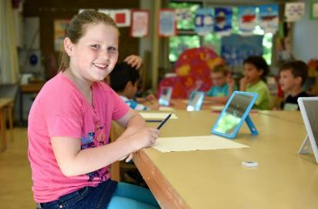
Who are your target groups? - Engaging the disengaged
Identify who they are
Ask them what they’d like to do
Understand their barriers – often competition, judgement, ability, prior experience
Health by stealth – active lessons/active travel
Think of ‘physical activity’ in the loosest sense
Notes:
We know it is easy to say to target those who could benefit from becoming more active but appreciate that it can be very difficult in practice. Here are some ideas based on what we have seen bring success elsewhere:
Identify who it is you are trying to target. Use yours's and your colleague’s knowledge of your pupils to know where you can focus your efforts for maximum impact. Are there children who have been less active through lockdown? Have their recent lifestyle changes made a difference to their health? Can you find ways to change their habits?
Asking them what they’d like to do is key. Maybe some children haven’t been asked before? Maybe they have interests that could help you provide them with a new opportunity, a super hero dance session or a cycle maintenance group may be just what is needed to engage them. Traditional sports activities could be their barrier.
Lets take time to understand what the barriers could be for some pupils. We know that for less active young people the barriers are likely to be the competitive environment, fear of judgement, their perceived lack of ability or their previous negative experiences. Consider how overcoming these can be built in to interventions, could you remove the element of competition? Not measure ‘success’? Make the emphasis about fun? Introduce an activity that no one will have done before to level the playing field?
Health by stealth –introducing activity into a young person’s day without them realising for example free play or forest schools where there is a broader appeal and the focus is not on physical activity but the children are still being active. Active travel is another example, the focus is on getting to school or home but in the meantime the child is getting valuable minutes of activity.
Think of ‘physical activity’ in the loosest sense, anything that is getting the heart rate and the breathing rate up is bringing the health benefits of activity. Schools have used activities like gardening, outdoor learning and loose parts play to engage different children in different activities.

Slide 61
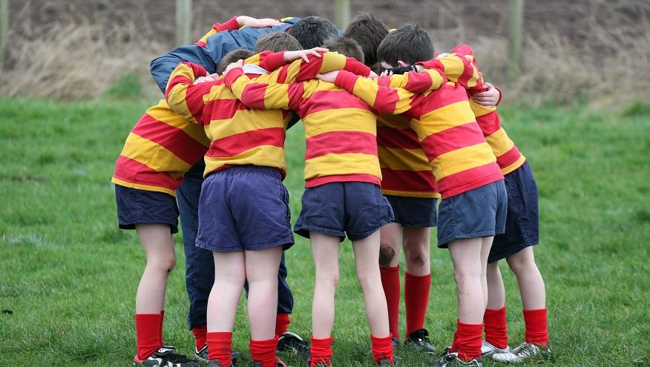
Engaging the disengaged
Role modelling: “children are great imitators, give them something great to imitate”
Engage with families
Think outside the box to overcome the barriers
Physical activity can be preventative – whole school physical activity can benefit all
Notes:
Role modelling – we know the importance of role models to young people’s development and making something ‘normal’ in school is a great way to encourage imitating behavior. We also know that through lockdown, 71% of children were being active with their parents and that children of active parents are much more likely to be active themselves. This reinforces what we know about the strength and impact of positive roles models.
Could some staff cpd sessions around the benefits of physical activity help encourage role modelling? Does your school environment support staff being active too? For example, charity challenges amongst staff? Staff being seen to travel actively? are images of staff being active included in displays around school? All these things help make physical activity part of the culture and seen as a normal thing to do.
It also tells us there is a significant opportunity to recognize the impact that positive role models within the family environment can have. We also know that the more active a parent is the more active their children are likely to be. Is there a chance to build on this? Some schools have run physical activity sessions that parents and siblings can attend too. Could information go home about what activities children have enjoyed?
Active travel can be a great way of families and children being active together outside of the school day. How can this funding support this? Is cycling or walking to school encouraged or is this where some of your funding can make a difference. Cycle to school days, cycle training, scooter libraries and walking buses could all be considered.
When we know what the specific barriers are for some children then coming up with an intervention that will help them can be a challenge but thinking outside the box and trying something new for them can really help. Themed activity days, circus skills workshops or even a silent disco have all had success in engaging targeted children.
Remember that improving physical activity levels for everyone can help ensure that young people don’t become ‘target’ young people.

Slide 62

Reminders
5 key indicators
Stick to grant conditions
Time spent on this can come from the funding
Monitor effectiveness
It’s an on-going plan
Notes:
All areas of spend must still be considered within the 5 key indicators, but these indicators allow for a broad and creative plan.
Stick to grant conditions, these conditions are made clear in module 2.
Providing the time spent on this work can be evidenced in line with the grant conditions then the cost related to that time can come from the funding.
Monitor the effectiveness of each area of spend. Is it achieving what you’d planned? If not, then how can you change or develop it to improve the impact?
Remember, its an ongoing plan that can be changed and developed during the year according to the needs of your pupils.

Slide 63
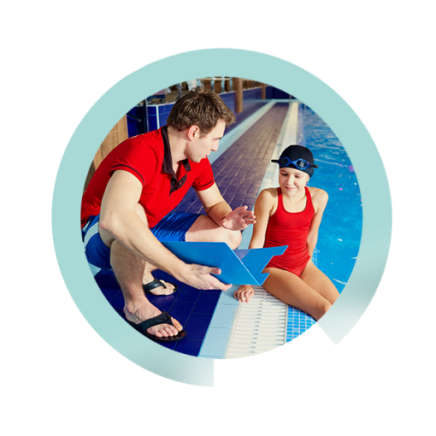
Considerations
If you intend to use your Premium for:
Staff CPD
External Providers
Download the Guide to Using Coaches in Schools
Notes:
There are some key considerations for what we know are common areas of spend:
Staff CPD:
Consider how you determine specific development needs for staff against your intended outcomes and do your homework to ensure that the identified training or upskilling approach will fill this skills gap.
Consider skills gaps across the school staff based on your plan, undertaking a skills audit once you have written your plan, considering if you have the right skills to deliver the plan, especially considering the changing responsibilities of staff in bubbling arrangements
Consider how you will maintain and monitor learning and development, attending a one-off course in isolation is unlikely to change practice
External Providers::
Coaches can be a fantastic resource offering skills, knowledge and experience where there is an identified gap but there are considerations when you are deploying external providers
First off, ensure that any external providers are deployed safely, considering how they interact with staff and pupils in your school and also whether they coach outside of your school and in community settings, what is your policy on this?
Be clear about what skills gaps you are filling through an external provider
Maintain ownership of your outcomes and set them with the coach/provider, you remain responsible for delivery and outcomes.
Coaches should not replace teachers - this is not effective or sustainable. Coaches and teachers have very different skills and knowledge that can be complimentary but a coach isn’t trained to do the job of a teacher. Also, consider if the funding stops tomorrow, how would you pay for the coach? If you couldn’t what would happen to the quality of your practice and the skills/knowledge of school staff?
Coach and teacher working together can be very powerful, if the coach is working to upskill a teacher set a timeline, this should not be an indefinite arrangement
The PE and Sport Premium cannot be used to cover PPA
Coaches can be fantastic assets when employed and deployed properly, a guide is available at the link on the slide to help effectively deploy external coaches and providers, it should be noted that this was written prior to covid-19.

Slide 64
Accountability
Schools have been given the funding directly and therefore trusted to make the right decisions for pupils so we need to maximise the impact.
Like other areas of school, there are also some measures in place to check that.
  Website reporting (complete by 31st July 2020)
  Ofsted
  The new RSHE curriculum
  School Governance
  CMO Guidelines
  Government Childhood Obesity Strategy
  Our desire to do the best for young people
Notes:
This was covered in module 2 but its important to remember how your decisions could be questioned and held to account.
Remember that all schools have been given the funding directly and therefore trusted to make the right decisions for pupils so we need to maximise the impact. Like other areas of school, there are also some measures in place to check that.

Slide 65
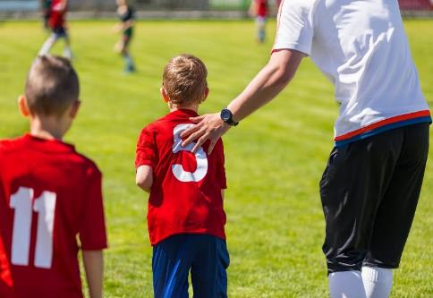
Summary
Review your practice using the recommended AfPE template
Reconsider what you are trying to achieve and be clear on your outcomes
Redesign your plan, being creative to achieve your new outcomes
Notes:
So in summary
Honestly review your previous spend, Use the recommended Afpe template if it works for you.
Be clear on what you are trying to achieve, link your outcomes to your SIDP
Redesign your plan to contribute to your new outcomes, use a combination of your learning from your review and what has worked previously with the freedom to be creative and think outside the box to tackle new challenges. Whilst schools have this funding for this academic year its an ideal opportunity to really take a risk with a new, creative intervention that just might make a significant difference!

Slide 66
Summary of the 3 modules
Physical activity is a tool that can help improve wider school outcomes and priorities
The PE and Sport Premium (ignore the name) is ring-fenced funding to help you to do that
Make the premium work for your school and your pupils with clear outcomes, good planning and creativity
Continually check and challenge the impact
Notes:
And to summarise the 3 modules that you have now completed:
Physical activity is a tool that can help improve wider outcomes and priorities
The PE and Sport Premium (ignore the name) is ring-fenced funding to help you to do that
Make the premium work for your school and your pupils with good planning and creativity
Continually check and challenge the impact of your spend

Slide 67

Support available through
Active Norfolk:
Workshops and CPD
Guides and resources
1:1 support
Active Lives Survey
https://www.activenorfolk.org/pe-sport-premium
N.B all support is available virtually
Notes:
There are a number of ways that Active Norfolk can support you to maximise the benefits of physical activity in your school from these workshops, to printed guides and 1:1 support.
all of this support is available virtually

Slide 68
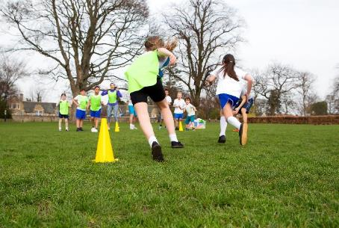
Additional support from national partners
Association for Physical Education:
  Safe Practice Manual - https://www.ukcoaching.org/safe-practice
  Covid self review tool for risk assessing PE - https://www.afpe.org.uk/physical-education/wp-content/uploads/Updated-COVID-19-Guidance-July-2020.pdf
Notes:
There are also a number of resources from national partners, especially in adapting to the new circumstances.
The association for Physical Education have been very active, it is worth checking in on their guidance and updates regularly. Links are included here for the latest version of their Safe Practice in physical education, school sport and physical activity Manual as well as a self review tool for risk assessing PE.

Slide 69
Additional support from national partners
Youth Sport Trust:
  A framework for returning to PE, sport and physical activity - https://www.youthsporttrust.org/sites/default/files/YST-Returning-to-School-Sport-Framework%20005.pdf
  Regularly updated guidance - https://www.youthsporttrust.org/coronavirus-support-schools
UK Active:
  Guidance on facilities and using external providers - https://www.ukactive.com/covid-19/
Notes:
The Youth Sport Trust have developed a framework for the return to school which includes ideas and considerations that could help your planning, they also have a covid guidance page which is regularly updated.
And UK Active have provided guidance around the opening of school sports facilities as well as advice and guidance on how external providers can operate safely in schools at the moment.

Slide 70
Get in touch
Stephen Hulme
stephen.hulme@activenorfolk.org
Jo Thompson
joanne.thompson@activenorfolk.org
01603 732381
https://www.activenorfolk.org/pe-sport-premium
Notes:
Thank you very much for attending these online modules, we hope they have been of use and inspired some thoughts.
For further questions or discussion, please don’t hesitate to get in touch with us and for more information, a link is included to the PE and Sport Premium section of our website.

